Slide 1



Workshop on Quantum Machine Learning
Gustavo Adolfo Patiño A. Ph.D
adolfo.patino@udea.edu.co
December 5th – 8th 2023
Mexico City, Mexico

Slide 2

Download this presentation and examples

Slide 3
Why Should You Bother With Quantum Machine Learning?
Machine learning is being applied to virtually every imaginable sector, from military to aerospace, from agriculture to manufacturing, and from finance to healthcare.
But these algorithms become increasingly hard to train because they consist of billions of parameters¹.
Quantum computers promise to solve such problems intractable with current computing technologies.
Their ability to compute multiple states simultaneously enables them to perform an indefinite number of superposed tasks in parallel.
An ability that promises to improve and to expedite machine learning techniques.
¹ For instance, GPT-4 has 1 trillion parameters, with a training cost of more than $100 million.

Slide 4
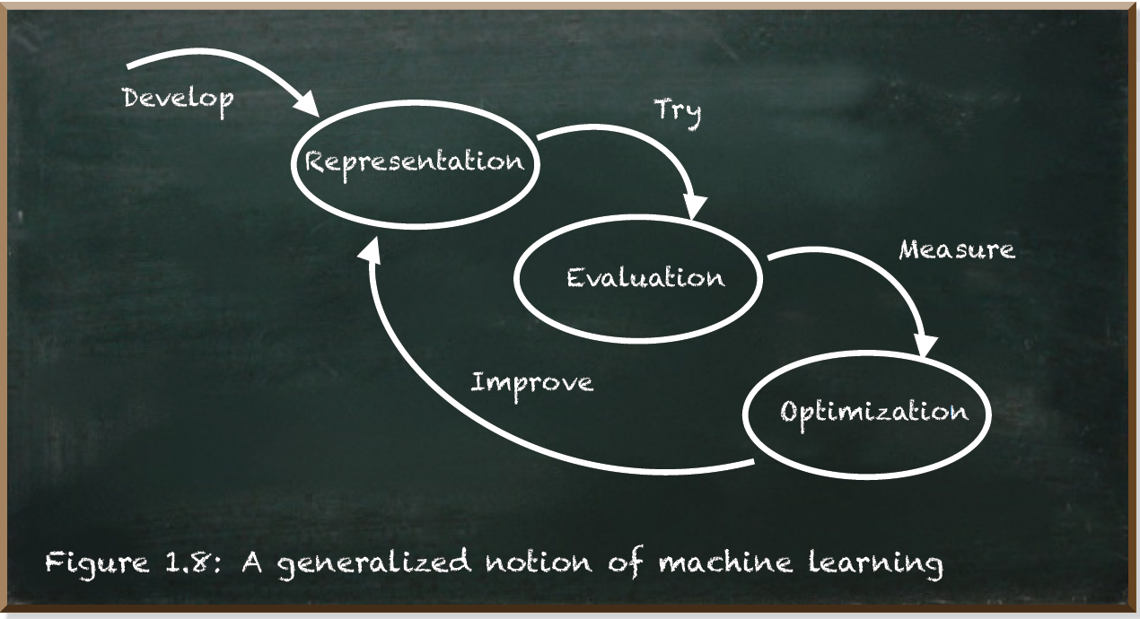
How Does Machine Learning Work?
There are myriads of machine learning algorithms out there, but every one of these algorithms has three components:
Notes:
The Representation depicts the inner architecture the algorithm uses to represent the knowledge. It may consist of a set of rules, instances, decision trees, support vector machines, neural networks, and others.
The Evaluation is a function to evaluate candidate algorithm parameterizations. Examples include accuracy, prediction and recall, squared error, posterior probability, cost, margin, entropy, and others.
The Optimization describes the way of generating candidate algorithm parameterizations. It is known as the search process. For instance, combinatorial optimization, convex optimization, and constrained optimization.

Slide 5
How Does Machine Learning Work? (…cont)
Once we settled for the architecture to represent the knowledge, we train our machine learning algorithm with examples.
Depending on the number of parameters, we need a lot of examples. The algorithm tries to predict the label of each example. We use the evaluation function to measure how the algorithm performed.
Finally, the optimizer adjusts the representation parameters in a way that promises better performance with regard to the measured evaluation.
It may even involve changing the architecture of the representation.

Slide 6
Quantum Machine Learning
Quantum machine learning is the use of quantum computing for the computation of machine learning algorithms.
The main characteristic of quantum computing is the ability to compute multiple states concurrently.
A quantum optimization algorithm can combine all possible candidates and yield those that promise good results.
Therefore, quantum computing promises to be exponentially faster than classical computers in the optimization of the algorithm.

Slide 7
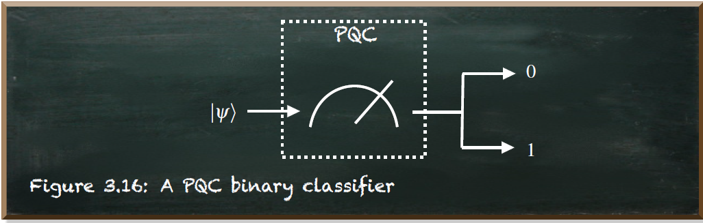
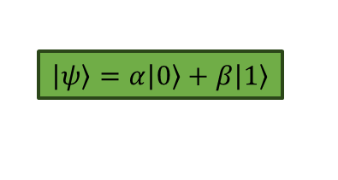
Quantum Machine Learning Parametrized Quantum Circuits (PQC)
PQC is a type of quantum circuit where some or all of the gates in the quantum circuit are parametrized.
This means that instead of using fixed values for certain operations, variables (parameters) are introduced.
These parameters are then adjusted or optimized during a training process to achieve a specific quantum computation or solve a particular problem.
$\left|\left.ψ\right\rangle \right.=α\left|\left.0\right\rangle \right.+β\left|\left.1\right\rangle \right.$

Slide 8
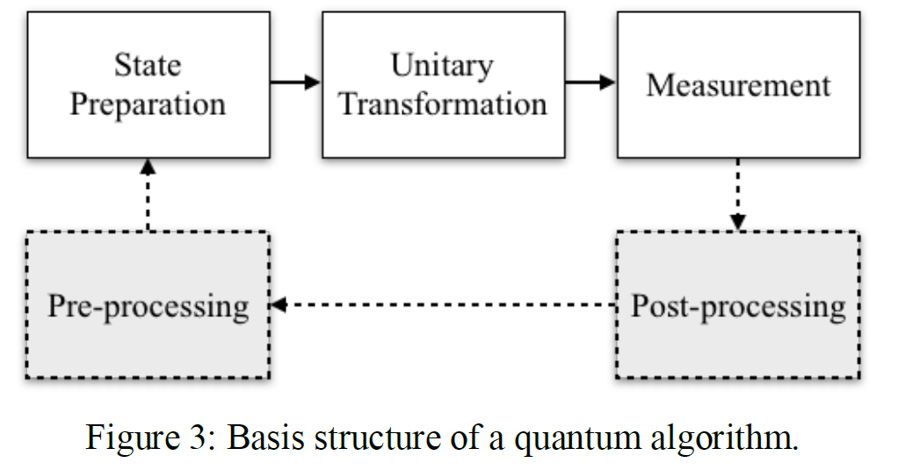
Reviewing: Basic Algorithmic Idea

Slide 9
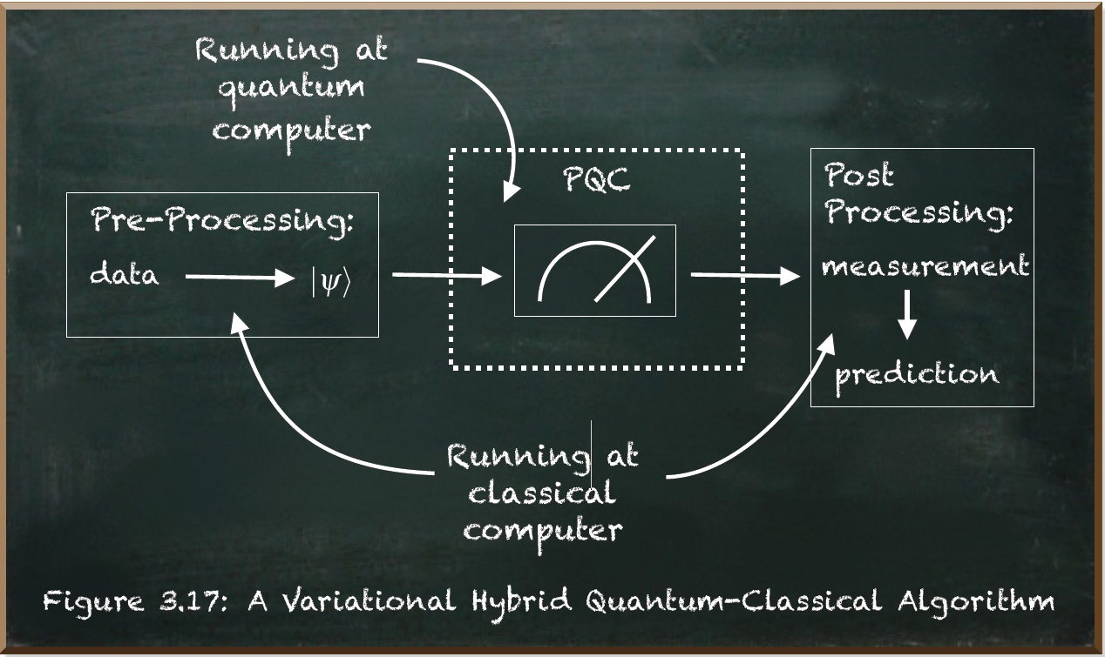
QML Variational Hybrid Quantum-Classical Algorithm
A Variational Hybrid Quantum-Classical Algorithm (VHQCA) is a broader category that encompasses algorithms that combine both quantum and classical processing in a synergistic manner.
VHQCA may involve using a quantum processor to perform certain quantum computations, while classical processors handle other tasks.
So, the overall algorithm consists of a closed loop between the classical and quantum components:
Pre-processing
PQC
Post-processing

Slide 10
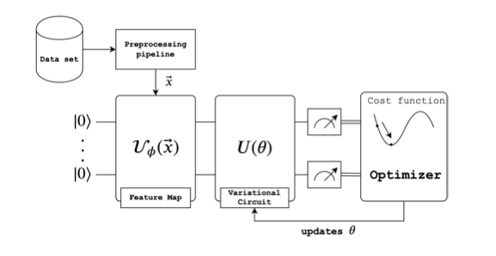
QML Variational Quantum Circuits (VQC)
A Variational Quantum Circuit is a quantum circuit that contains parameters that can be adjusted to minimize or maximize a certain objective function.
The parameters of the quantum circuit are varied in a classical optimization loop, and the quantum circuit is repeatedly executed on a quantum processor or simulator to find the optimal set of parameters that minimizes the objective function.

Slide 11
Variational Quantum Classifier (VQC)
Variational quantum algorithms are called "variational" because they involve a variation or optimization of parameters to minimize or maximize a certain objective function.

Slide 12
QML Applications of VQCs
Classification
Regression
Clustering
Optimization

Slide 13
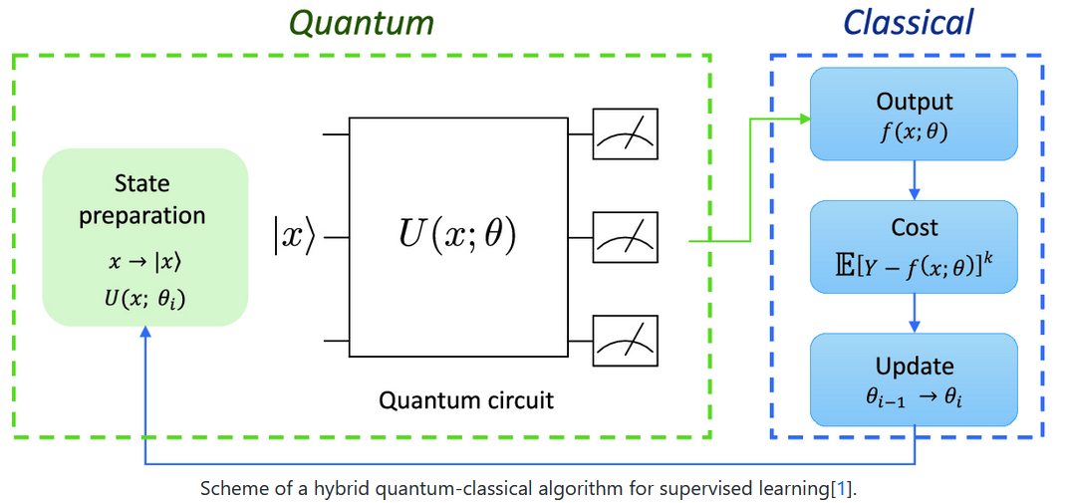
Quantum Machine Learning
The optimization loop involves classical computations, making VQC a quantum-classical hybrid approach.

Slide 14
Classical Preprocessing For instance: One-Hot Decoding
In this encoding, each category is represented by a binary vector, where all elements are zero except for the one corresponding to the index of the category.
This is useful when working with machine learning models that require numerical input, as it transforms categorical data into a format that can be easily processed.
Here's how one-hot encoding works:
Each category is assigned a unique integer index.
A binary vector is created for each category.
In the binary vector, the element at the index corresponding to the category is set to 1, while all other elements are set to 0.

Slide 15
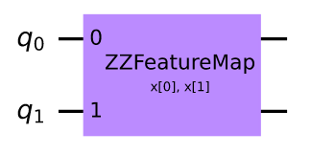
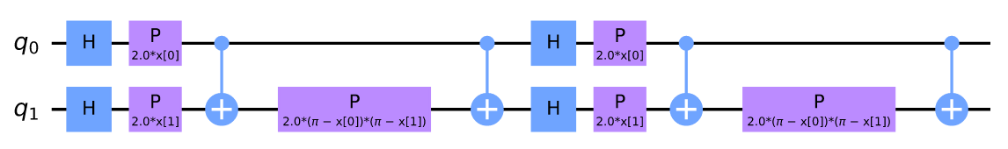

Quantum embedding Feature Map
A quantum embedding represents classical data as quantum states in a Hilbert space via a quantum feature map.
It takes a classical datapoint $X$ and translates it into a set of gate parameters in a quantum circuit, creating a quantum state $\left.\left|ψ_{X}\right.\right\rangle$.

Slide 16
Parametrized Quantum Circuit Ansatz
An ansatz is typically a quantum circuit with trainable parameters (also known as variational parameters or angles). These parameters are adjusted during the optimization process to minimize a cost function related to the specific machine learning task.
Classical optimization algorithms adjust the parameters of the ansatz based on the feedback from the cost function evaluated on a quantum computer or quantum simulator.

Slide 17
Parametrized Quantum Circuit Ansatz (..cont)
Popular ansatz structures include:
Hardware Efficient Ansatz (HEA): Designed to be compatible with the connectivity of a specific quantum device.
Random Ansatz: Parameters are randomly initialized, and the optimizer learns suitable values during training.
Entangled Layer Ansatz: Alternating layers of entangling gates and single-qubit rotations.

Slide 18
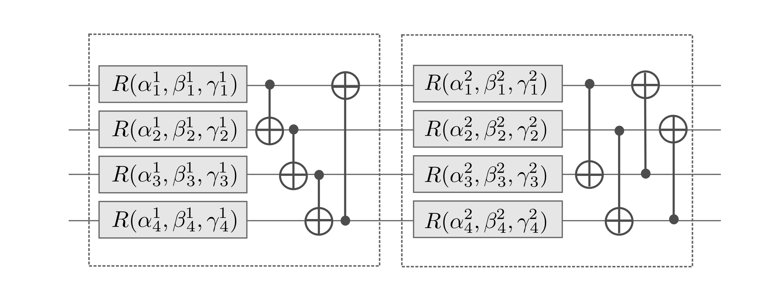
Ansatz Strongly Entangling Layers
This is an example of two 4-qubit strongly entangling layers:

Slide 19
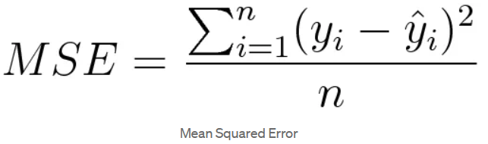
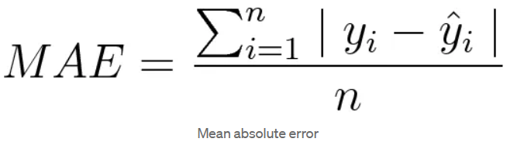
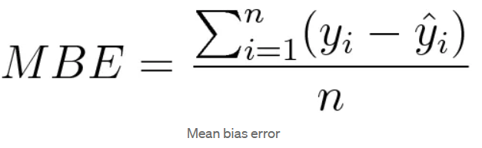
Classical Post-processing Loss Function
Machines learn by means of a loss function.
It’s a method of evaluating how well specific algorithm models the given data. If predictions deviates too much from actual results, loss function would result in a very large number.
Gradually, with the help of some optimization function, loss function learns to reduce the error in prediction.

Slide 20
Classical Post-processing Optimizer
It is a routine used to adjust the parameters of a quantum circuit to minimize or maximize a specific cost function.
Common classical optimizers used in QML include:
Gradient Descent-Based Optimizers
Nelder-Mead (NM)
Conjugate Gradient (CG)
COBYLA (Constrained Optimization BY Linear Approximations)
Limited-memory Broyden-Fletcher-Goldfarb-Shanno (L-BFGS)
The choice of optimizer depends on the specific characteristics of the optimization problem, the nature of the cost function, and the available resources. Different optimizers may converge at different rates or perform better under certain conditions.

Slide 21
Bibliography
Frank Zickert. Hands-On Quantum Machine Learning With Python. Volume 1: Get Started. Available on: https://prod-pyqml-bucket.s3-eu-west-1.amazonaws.com/pyqml.pdf
Seth Lloyd. Quantum Machine Learning. Massachusetts Institute of Technology and Keio University. USA and Japan. Available on: https://www.youtube.com/watch?v=Lbndu5EIWvI
Nathaniel E. Helwig. Data, Covariance, and Correlation Matrix. University of Minnesota. Available on: http://users.stat.umn.edu/~helwig/notes/datamat-Notes.pdf
Nathaniel E. Helwig. Nonparametric Independence Tests. University of Minnesota. Available on: http://users.stat.umn.edu/~helwig/notes/npind-Notes.pdf

